Slide 1
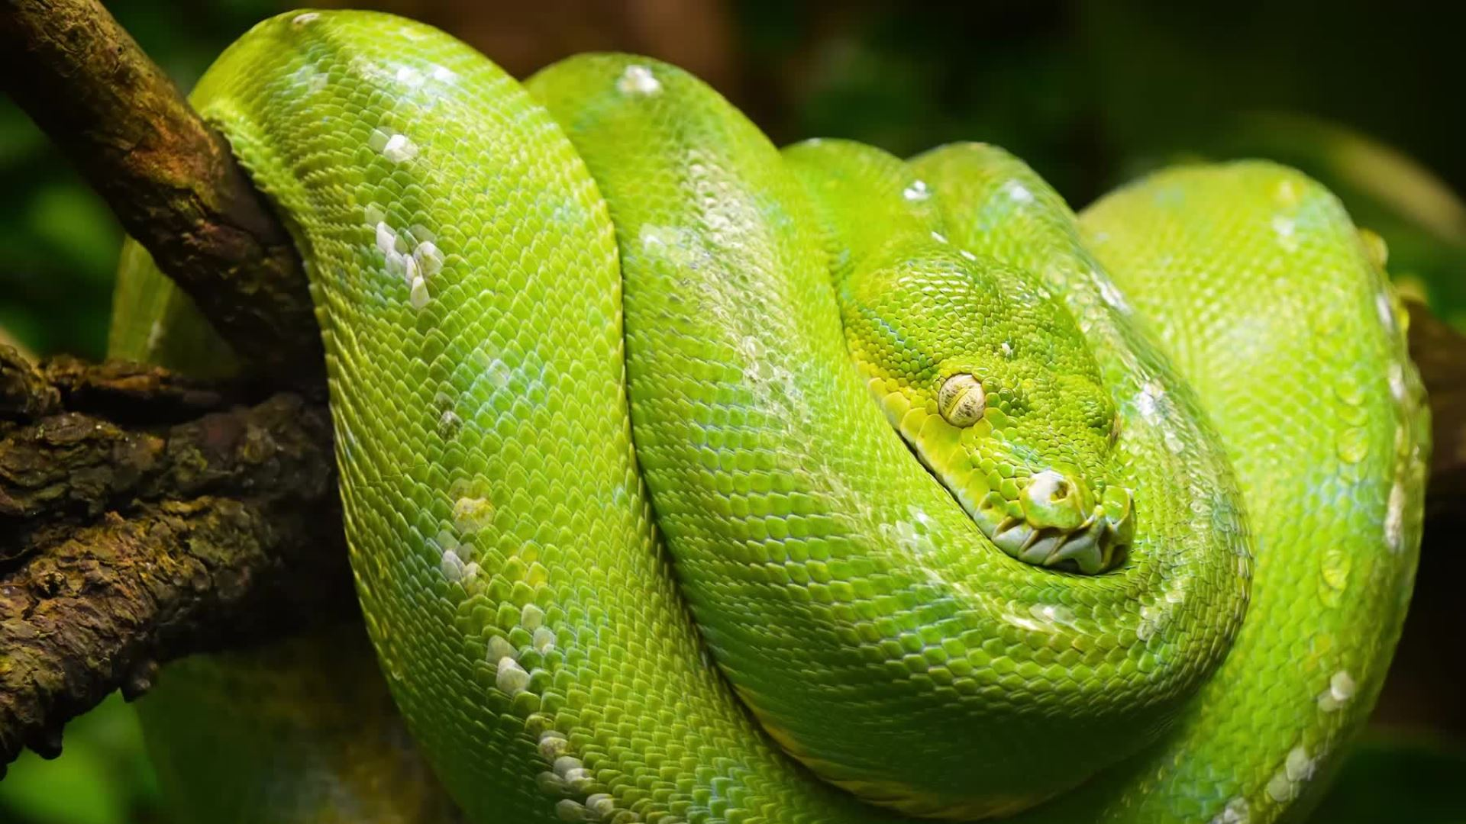
Python Basics
Myrzash Sultan

Slide 2
Week 1
Values, Data types, Variables, functions
Operators and Operands
Syntax and Semantics
Error types
Modules (Turtle, Random)

Slide 3
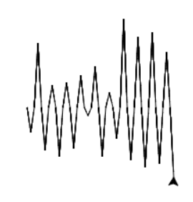
Turtle Drawing
import turtle
import random
import math
wn = turtle.Screen()
wave = turtle.Turtle()
for _ in range(20):
uzyndyq = random.randint(8,100)
burysh = math.degrees(math.acos(4/uzyndyq))
print(burysh)
wave.right(burysh)
wave.forward(uzyndyq)
wave.left(burysh*2)
wave.forward(uzyndyq)
wave.right(burysh)
uzyndyq = random.randint(8,100)
burysh = math.degrees(math.acos(4/uzyndyq))
print(burysh)
wave.left(burysh)
wave.forward(uzyndyq)
wave.right(burysh*2)
wave.forward(uzyndyq)
wave.left(burysh)

Slide 4
Week 2
Lists, Tuples
Strings, indexes
Slice operator [:1]
len() range() split() join()
for loop

Slide 5
String, split(), list, accumulation, for loop
week_temps_f = "75.1,77.7,83.2,82.5,81.0,79.5,85.7"
temps_lst = week_temps_f.split(",")
sum_val = 0
for i in temps_lst:
sum_val += float(i)
avg_temp = sum_val / len(temps_lst)

Slide 6
Week 3
Boolean
Logical operators if, elif, else
Tests with assert
Accumulator Pattern with Conditionals

Slide 7
Accumulator Pattern with Conditionals and test with assert
s = "singing in the rain and playing in the rain are two entirely different situations but both can be fun"
vowels = ['a','e','i','o','u']
num_vowels = 0
for i in s:
if i in vowels:
num_vowels +=1
assert num_vowels <= len(s)

Slide 8
Week 4
Mutability
Objects and Reference
Aliasing and Cloning
List methods: "{}".format()
Accumulator patterns, iterator naming

Slide 9
Sequence, Accumulator, Iterator variable naming pattern
sequence = [1,2,3]
accumulator = 0
for iterator in sequence:
accumulator += iterator
print(accumulator)

Slide 10
The End

